Slide 1

Digital Relationships
3rd Partnermeeting
Mechelen, Belgium

Slide 2
9:00 TOP 1
Welcome by the hosting organization
Welcome by the project management
Organizational matters

Slide 3
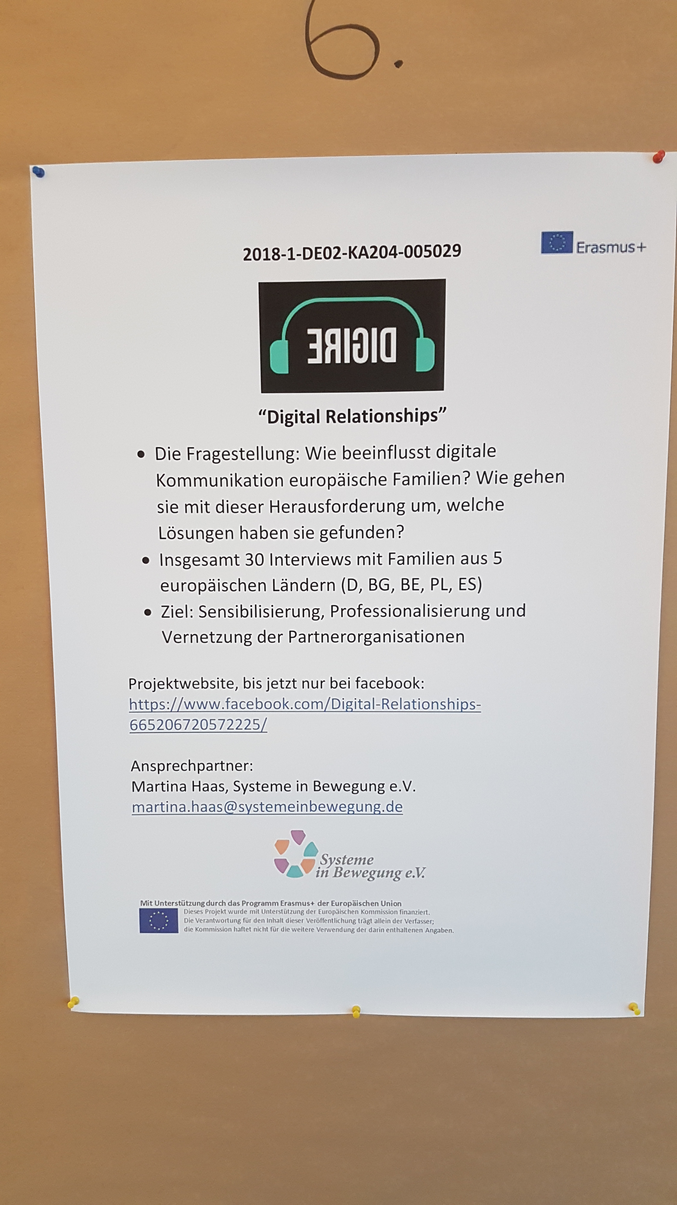
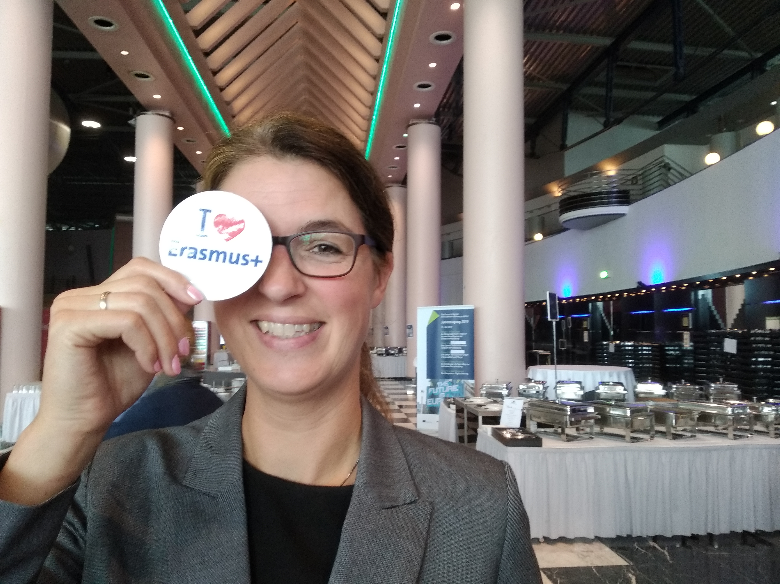
TOP 2
Report about the presentation of the project at the annual meeting of the National Agency

Slide 4
Completion of the interim report
The evaluation of the content of the interim report of your strategic partnership "Digital Relationships" has shown that the project is going very well.
The previous project activities were carried out as planned and successfully as well as described in detail in this interim report.
All partner organisations are very committed to implementing the measures formulated in the project proposal. The results contribute to the professionalisation of the staff of the project partner organisations.
In addition, the current project results are already being disseminated intensively both at events and via social media.

Slide 5
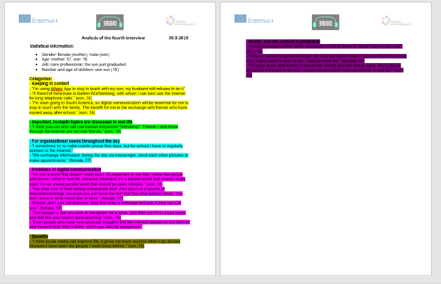
TOP 3
Presentation of the results of the interviews
First the individual results of the partners
Creating the synopsis:
first mark the
individual categories
in different colors
then copy all categories
together in one document
And send it to me… ;)

Slide 6
TOP 4
Discussion of the results and implementation
TOP 5
Development of a didactically useful and appropriate synopsis
Suggestion: All partners compile their results by categories
SiB writes a summary in English, Sambucusforum reads and corrects the text if necessary
all partners translate in their language.

Slide 7
TOP 6
Development of dissemination materials
TOP 7
Exchange of dissemination strategies
Do we want to afford giveaways?
Suggestion: Dissemination of the results in the form of a PDF via our own websites and social networks.

Slide 8
TOP 8
Report on the results of the internal evaluation
Evaluation of the day
All results from the last meetings were consistently positive.
There is one more evaluation form to come, the last one.

Slide 9

See you at Dinner!
19:00
Café Belge, Grote Markt 2

